Slide 1

Mathematical Foundations for Data Science
MFDS Team

Slide 2
DSECL ZC416, MFDS
Lecture No. 4

Slide 3
Agenda
Definition and examples of eigenvalues
Computation of eigenvalues and eigenvectors
Diagonalization and Jordan Canonical Form
Gerschgorin’s theorem
Properties of eigenvalues and eigenvectors

Slide 4

Eigenvalue Problem
A matrix eigenvalue problem considers the vector equation
(1) Ax = λx,
where A is a given square matrix, λ an unknown scalar(real or complex), and x an unknown vector.
The task is to determine λ’s and x’s (dependent on λ’s)that satisfy (1).
Since x = 0 is always a solution for any λ,we only admit solutions with x ≠ 0.
The solutions to (1) are given the following names: The λ’s that satisfy (1) are called eigenvalues of A and the corresponding nonzero x’s that also satisfy (1) are called eigenvectors of A.

Slide 5
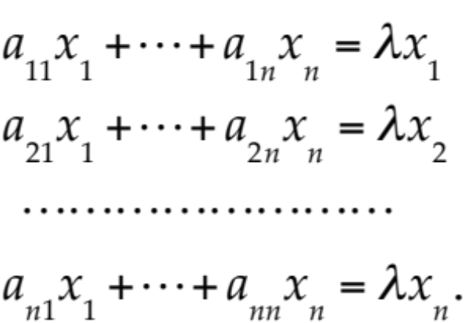

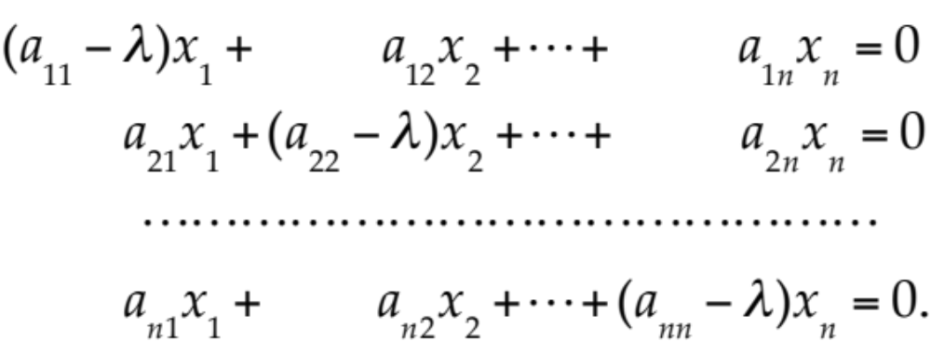

Eigen Value Analysis
This example illustrates the general case as follows. Equation (1) written in components is
Transferring the terms on the right side to the left side, we have
(2)

Slide 6



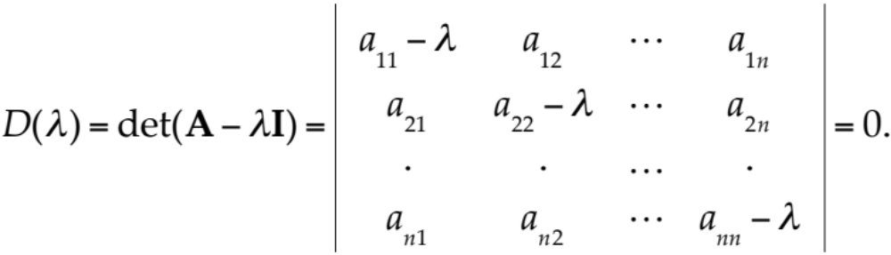

Eigen Value Analysis
In matrix notation,
(3)
By Cramer’s theorem in Sec. 7.7, this homogeneous linear system of equations has a nontrivial solution if and only if the corresponding determinant of the coefficients is zero:
(4)

Slide 7
Eigenvalue Analysis
A − λI is called the characteristic matrix and D(λ) the characteristic determinant of A. Equation (4) is called the characteristic equation of A. By developing D(λ) we obtain a polynomial of nth degree in λ. This is called the characteristic polynomial of A.

Slide 8
Eigenvalues
Theorem 1
Eigenvalues
The eigenvalues of a square matrix A are the roots of the characteristic equation (4) of A.
Hence an n × n matrix has at least one eigenvalue and at most n numerically different eigenvalues.
The eigenvalues must be determined first.
Once these are known, corresponding eigenvectors are obtained from the system (2), for instance, by the Gauss elimination, where λ is the eigenvalue for which an eigenvector is wanted.

Slide 9



Eigen Space
Theorem 2
Eigenvectors, Eigenspace
If w and x are eigenvectors of a matrix A corresponding to the same eigenvalue λ, so are w + x (provided x ≠ −w) and kx for any k ≠ 0.
Proof: follows from definition.
Hence the eigenvectors corresponding to one and the same eigenvalue λ of A, together with 0, form a vector space called the eigenspace of A corresponding to that λ.

Slide 10
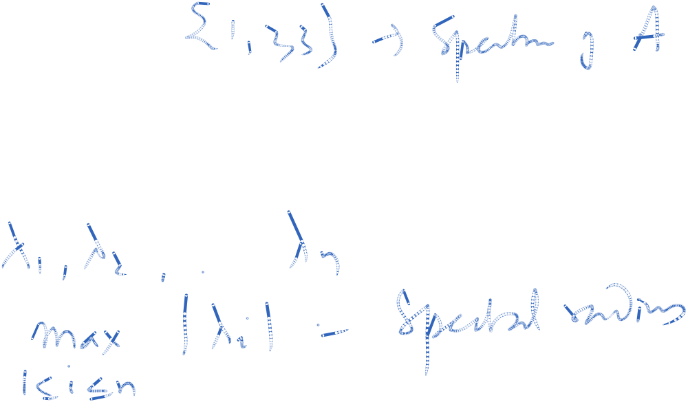
Spectrum
The set of all the eigenvalues of A is called the spectrum of A. We shall see that the spectrum consists of at least one eigenvalue and at most of n numerically different eigenvalues.
The largest of the absolute values of the eigenvalues of A is called the spectral radius of A.

Slide 11
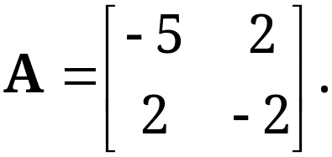
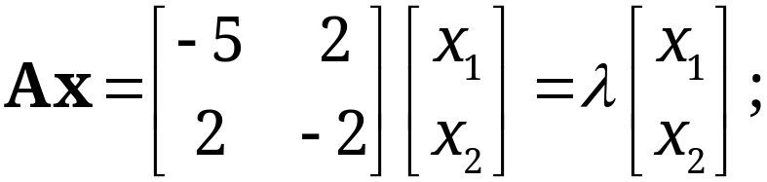
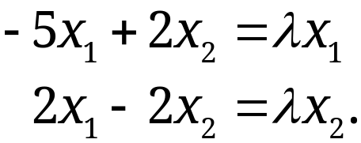
Determination of Eigen Value and Eigen Vector
Solution.
(a) Eigenvalues. These must be determined first.
Equation (1) is in components

Slide 12
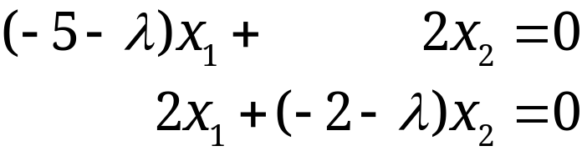

Example
Solution. (continued 1)
(a) Eigenvalues. (continued 1)
Transferring the terms on the right to the left, we get
(2*)
This can be written in matrix notation
(3*)
Because (1) is Ax − λx = Ax − λIx = (A − λI)x = 0,
which gives (3*).

Slide 13
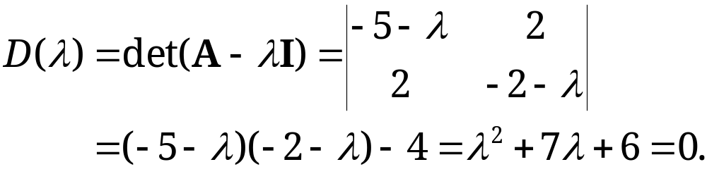
Example
Solution. (continued 2)
(a) Eigenvalues. (continued 2)
We see that this is a homogeneous linear system. By Cramer’s theorem in Sec. 7.7 it has a nontrivial solution (an eigenvector of A we are looking for) if and only if its coefficient determinant is zero, that is,
(4*)

Slide 14
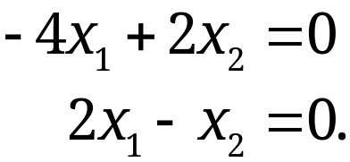
Example
Solution. (continued 3)
(a) Eigenvalues. (continued 3)
We call D(λ) the characteristic determinant or, if expanded, the characteristic polynomial, and D(λ) = 0 the characteristic equation of A. The solutions of this quadratic equation are λ₁ = −1 and λ₂ = −6. These are the eigenvalues of A.
(b₁) Eigenvector of A corresponding to λ₁. This vector is obtained from (2*) with λ = λ₁ = −1, that is,

Slide 15
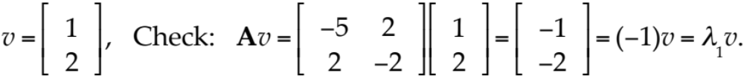
Example
Solution. (continued 4)
(b₁) Eigenvector of A corresponding to λ₁. (continued)
A solution is x₂ = 2x₁, as we see from either of the two equations, so that we need only one of them. This determines an eigenvector corresponding to λ₁ = −1 up to a scalar multiple. If we choose x₁ = 1, we obtain the eigenvector

Slide 16
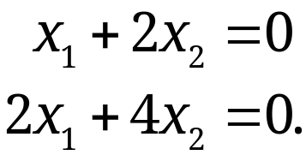
Example
Solution. (continued 5)
(b₂) Eigenvector of A corresponding to λ₂.
For λ = λ₂ = −6, equation (2*) becomes
A solution is x₂ = −x₁/2 with arbitrary x₁. If we choose x₁ = 2, we get x₂ = −1. Thus an eigenvector of A corresponding to λ₂ = −6 is

Slide 17
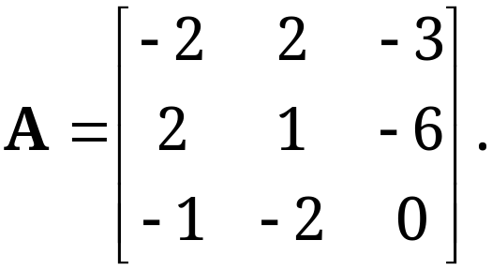
Multiple Eigen Values
Example 2: Find the eigenvalues and eigenvectors of
Solution.
For our matrix, the characteristic determinant gives the characteristic equation
−λ³ − λ² + 21λ + 45 = 0.
The roots (eigenvalues of A) are λ₁ = 5, λ₂ = λ₃ = −3.

Slide 18
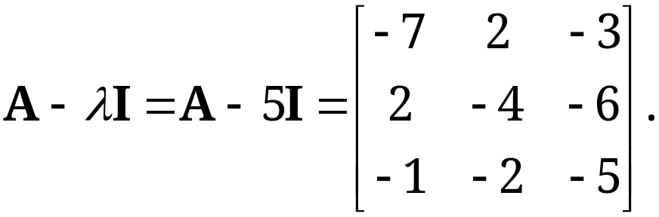
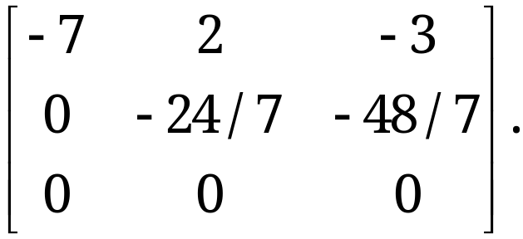
Multiple Eigen Values
Solution. (continued 1)
To find eigenvectors, we apply the Gauss elimination (Sec. 7.3) to the system (A − λI)x = 0, first with λ = 5
and then with λ = −3 . For λ = 5 the characteristic matrix is
It row-reduces to

Slide 19
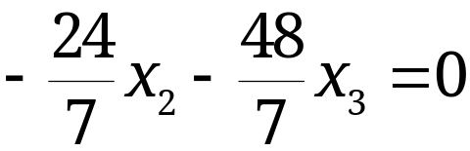
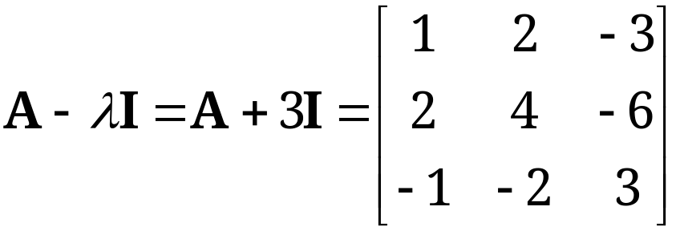
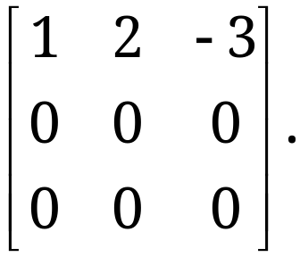
Multiple Eigen Values
Solution. (continued 2)
Hence it has rank 2. Choosing x₃ = −1 we have x₂ = 2 from
and then x₁ = 1 from −7x₁ + 2x₂ − 3x₃ = 0.
Hence an eigenvector of A corresponding to λ = 5 is
x₁ = [1 2 −1]^{T}.
For λ = −3 the characteristic matrix
row-reduces to

Slide 20
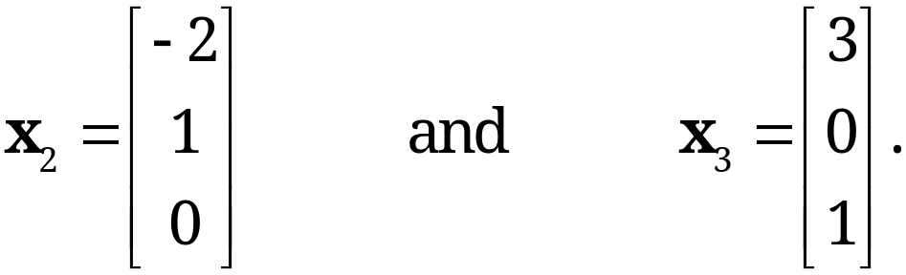
Multiple Eigenvalues
Solution. (continued 3)
Hence it has rank 1.
From x₁ + 2x₂ − 3x₃ = 0 we have x₁ = −2x₂ + 3x₃. Choosing
x₂ = 1, x₃ = 0 and x₂ = 0, x₃ = 1, we obtain two linearly independent eigenvectors of A corresponding to λ = −3 [as they must exist by (5), Sec. 7.5, with rank = 1 and n = 3],

Slide 21
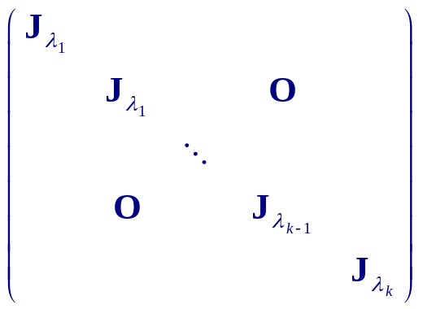
Jordan Canonical Form
Suppose A has an eigenvalue λ_{i} is repeated k times, we can find the nullspace of (A- λ_{i} I)^{j} 1 ≤ j ≤ k and form P
In this case P⁻¹AP = J, where J is an upper triangular matrix with superdiagonal 1
Exemplification

Slide 22
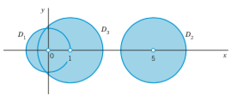
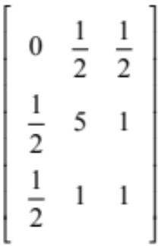



Gerschgorin’s Theorem
Theorem gives the bound on Eigenvalues
Every eigenvalue of matrix A_{nxn} satisfies :
λ – {a_{ii}} ≤ Σ |{a_{ij}}|, i = 1,2,....n
Example : A =
We get Gerschgorin disks D₁: Centre 0, radius 1
D₂ : Centre 5, radius 1.5
D₃ : Centre 1, radius 1.5
The centers are main diagonal entries of A. These would
be the eigenvalues of A if A were diagonal
j≠ i

Slide 23
Algebraic Multiplicity &Geometric Multiplicity
The order M_{λ} of an eigenvalue λ as a root of the characteristic polynomial is called the algebraic multiplicity of λ. The number m_{λ} of linearly independent eigenvectors corresponding to λ is called the geometric multiplicity of λ. Thus m_{λ} is the dimension of the eigenspace corresponding to this λ.
Since the characteristic polynomial has degree n, the sum of all the algebraic multiplicities must equal n. In Example 2 for λ = −3 we have m_{λ} = M_{λ} = 2. In general, m_{λ} ≤ M_{λ}, as can be shown. The difference Δ_{λ} = M_{λ} − m_{λ} is called the defect of λ. Thus Δ₋₃ = 0 in Example 2, but positive defects Δ_{λ} can easily occur.

Slide 24


























Special cases
Theorem 3
Eigenvalues of the Transpose
The transpose A^{T} of a square matrix A has the same eigenvalues as A.
Basis of Eigenvectors
If an n × n matrix A has n distinct eigenvalues, then A has a basis of eigenvectors x₁, … , x_{n} for R^{n}.

Slide 25


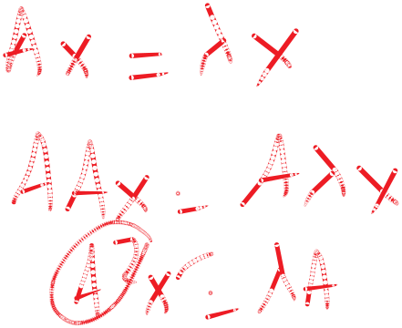
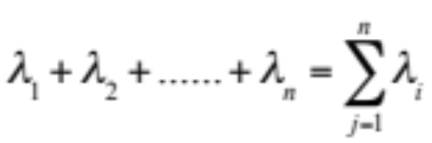

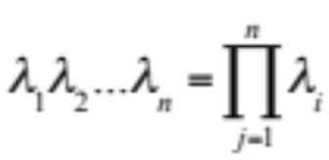



Eigenvalue properties
If λ is eigenvalue of A, then λ^{k} is eigenvalue of A^{k}.
If λ is eigenvalue of A and A is invertible, then is
eigenvalue of A⁻¹.
Trace(A) = Sum of eigenvalues of matrix
=
Determinant(A) = Product of eigenvalues of matrix
=

Slide 26
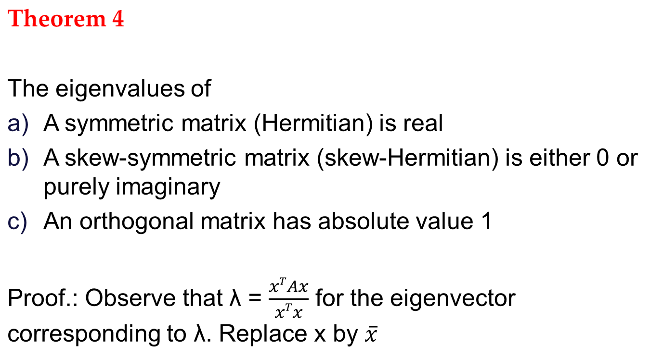


Eigenvalue properties

